Slide 1
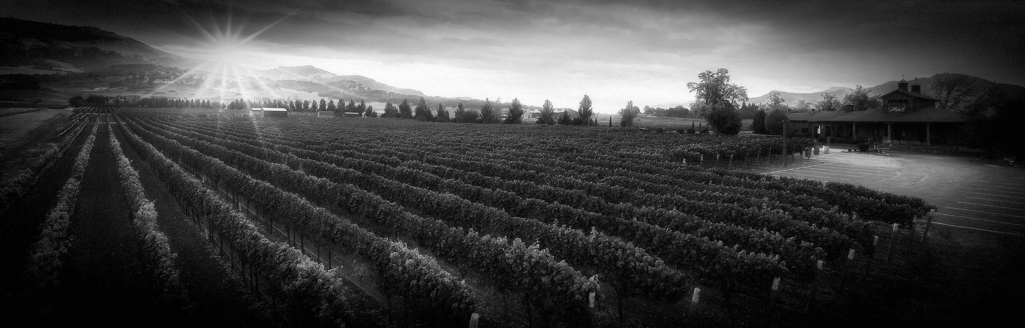
Wine recommender
Which wine is made for you?

Slide 2
The Target
Edouard : ”During my trip to Argentina, I really liked a bottle: El Enemigo 2012 Bonarda. I would like to find a similar French wine. Do you have an idea…?”
“Sure! Take a look on this wines :”
Paul Jaboulet Aîné 2010 Domaine des Pierrelles – 150 $
Loup Blanc 2007 La Mère Grand Red – 25$
Blanville 2017 Château Haut-Blanville Peyrals Red – 20$

Slide 3
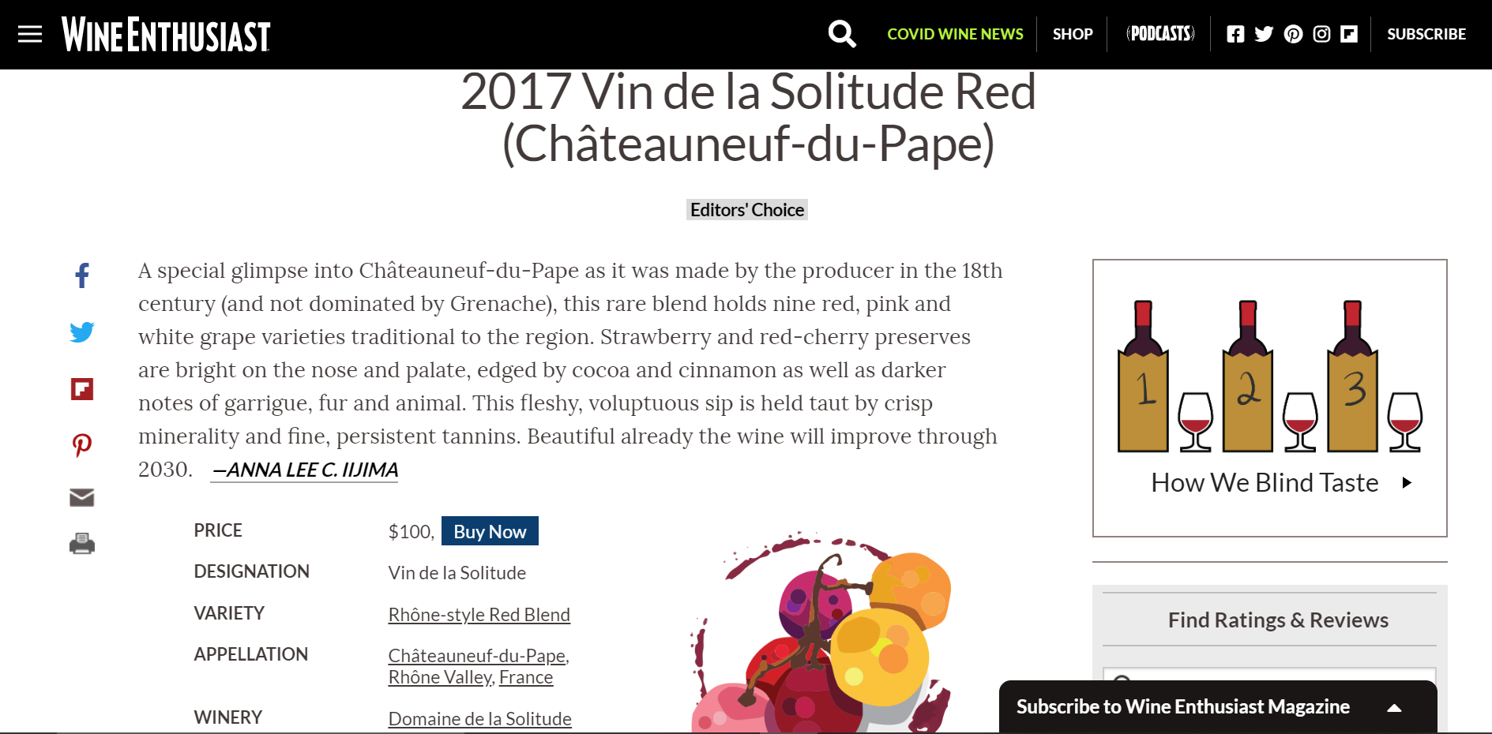
The Dataset
Title
Description
Country
Province
Region
Points
Price
Variety
Winery
Vintage
167,669 val
167,669 val
44 val
490 val
757 val
From 80 to 100
From 4 to 3,400 $
841 val
19,596 val
From 1904 to 2019

Slide 4


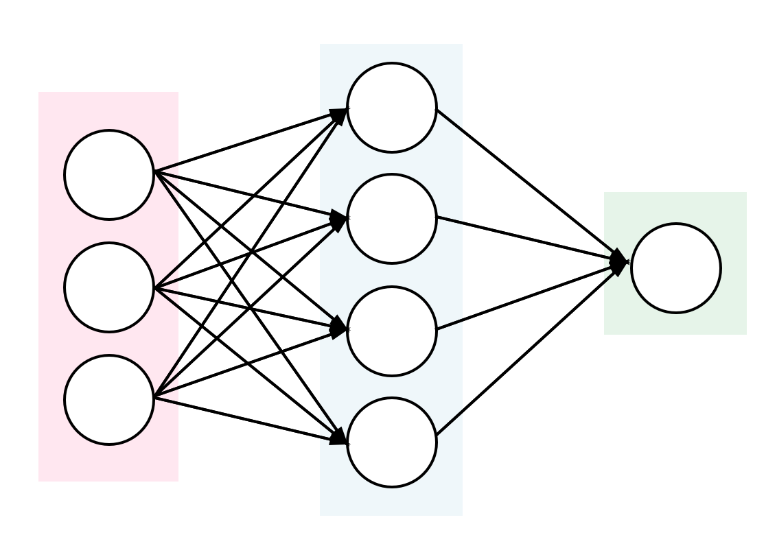


The steps
Description analysis
Modelling
Model evaluation
Deployment

Slide 5
The Wine Description
"Aromas of pineapple and lemongrass carry this fruit-forward Chardonnay[…]"
{“ aromas ” : 0.05, “”pineapple ” : 0.2, “ lemongrass” : 0.5, “fruit-forward” : 0.8 }
lemongrass
aromas
pineapple
lemongrass
Fruit-forward
Wine vector
pineapple
Fruit-forward
aromas
x1
0.1
0.7
-0.1
0.6
0.1
0.7
-0.1
0.6
0.1
x2
-0.8
0.2
-0.2
-1.6
! Weighting process !
-0.8
0.2
-0.2
-1.6
-1.1
0.05.
+0.2.
+0.5
+0.8
=
x100
0.5
-0.2
0.8
-0.3
0.5
-0.2
0.8
-0.3
0.3

Slide 6
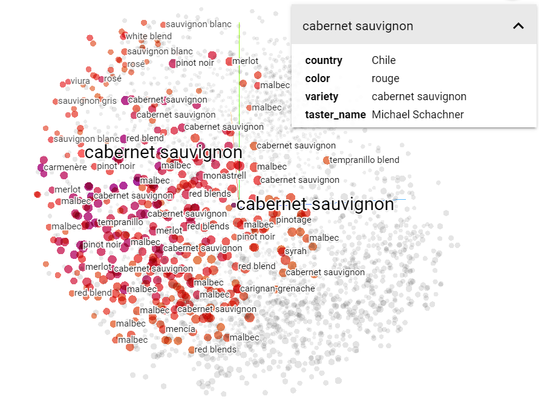
The T-SNE visualization

Slide 7
The Distance computing
wine 1
my wine
wine 2
wine 3
Model reliability on wine color: 91%

Slide 8
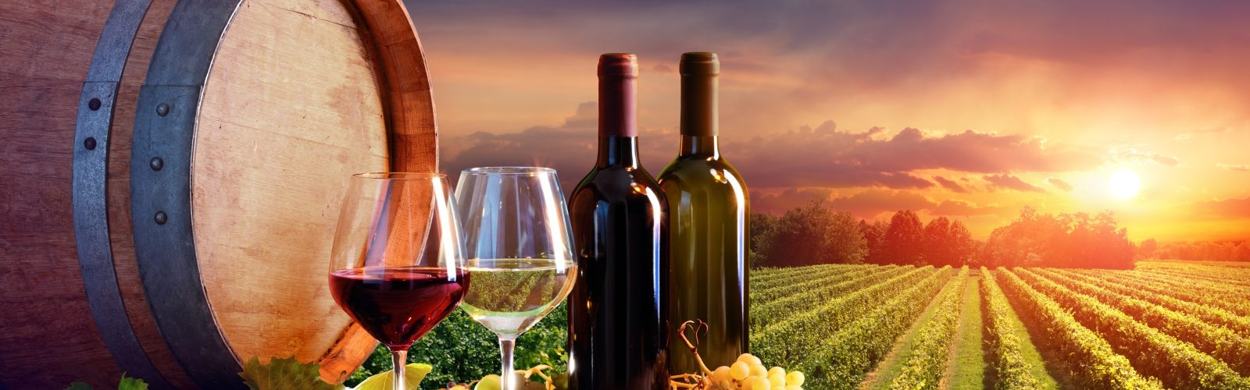
The App
https://wine-recommender-wagon.herokuapp.com/

